Slide 1
AVL Trees Implementation

Slide 2
AVL Trees: Implementation
struct AvlNode
{
Item Element;
AvlNode* Left;
AvlNode* Right;
int Height;
};

Slide 3
AVL Trees: Implementation
int getHeight(AvlNode *T);
AvlNode* Find( Item X, AvlNode* T );
AvlNode* Insert( Item X, AvlNode* T );
AvlNode* Delete( Item X, AvlNode* T );

Slide 4
AVL Trees: Implementation
int getHeight( AvlNode* P )
{
if( P == NULL )
return -1;
else
return P->Height;
}

Slide 5
AVL Trees: Implementation
AvlNode* Insert( Item X, AvlNode *&T )
{ if ( T == NULL )
{ /* Create and return a one-node tree */
T = new AvlNode;
T->Element = X;
T->Height = 0;
T->Left = T->Right = NULL;
}
else if ( X < T->Element )
{ T->Left = Insert( X, T->Left );
if ( getHeight( T->Left ) - getHeight( T->Right ) == 2 ) if ( X < T->Left->Element )
T = LeftLeft( T )
else
T = LeftRight( T );
}

Slide 6
AVL Trees: Implementation
else if ( X > T->Element )
{ T->Right = Insert( X, T->Right );
if( getHeight( T->Right ) - getHeight( T->Left ) == 2 )
if( X > T->Right->Element )
T = RightRight( T );
else
T = RightLeft( T );
}
/* Else X is in the tree already; we'll do nothing */
T->Height = Max( Height( T->Left ), Height( T>Right ) ) + 1;
return T;
}

Slide 7
AvlNode* Insert( Item X, AvlNode *&T )
{ if ( T == NULL )
{ /* Create and return a one-node tree */
T = new AvlNode;
T->Element = X;
T->Height = 0;
T->Left = T->Right = NULL;
}
else if ( X < T->Element )
T->Left = Insert( X, T->Left );
else if ( X > T->Element )
T->Right = Insert( X, T->Right );
T->Height = Max( getHeight( T->Left ), getHeight( T>Right ) ) + 1;
return T;
}

Slide 8
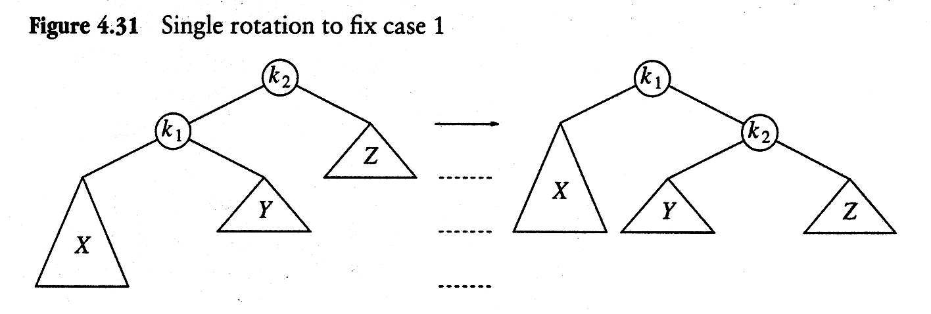
AVL Trees: Implementation
AvlNode* LeftLeft (AvlNode *&K2 )
{
AvlNode* K1;
K1 = K2->Left;
K2->Left = K1->Right;
K1->Right = K2;
K2->Height = Max( getHeight(K2->Left), getHeight(K2->Right) ) + 1;
K1->Height = Max( getHeight(K1->Left), getHeight(K1->Right )) + 1;
return K1; /* New root */
}

Slide 9
AVL Trees: Implementation
AvlNode* RightRight (AvlNode*& K2 )
{
AvlNode* K1;
K1 = K2->Right;
K2->Right = K1->Left;
K1->Left = K2;
K1->Height = Max( getHeight(K1->Left), getHeight(K1->Right) ) + 1;
K2->Height = Max( getHeight(K2->Right), getHeight(K2->Left) ) + 1;
return K1; /* New root */
}

Slide 10
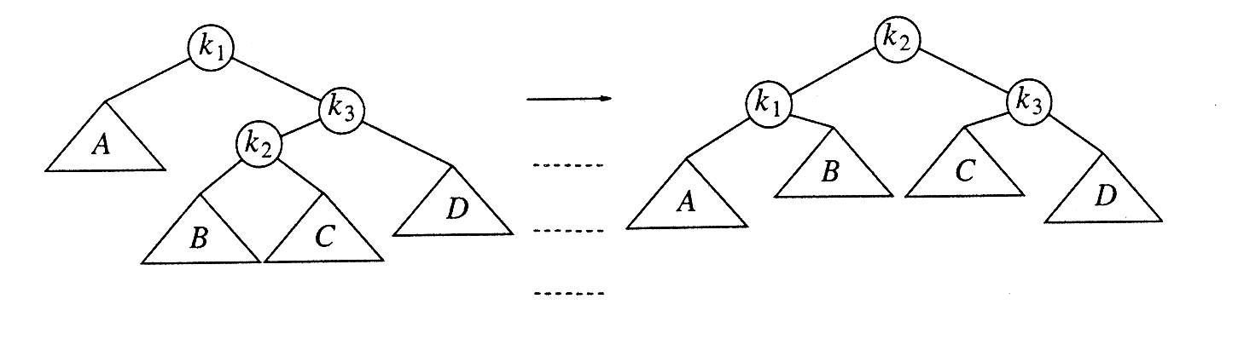
AVL Trees: Implementation
AvlNode* RightLeft(AvlNode*& K1)
{
}

Slide 11
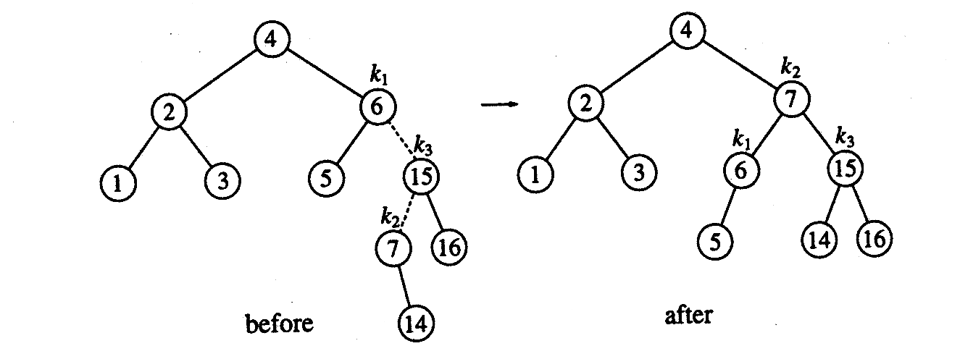
AVL Trees:
Insert 14

Slide 12
RL Rotation:
Insert 14

Slide 13
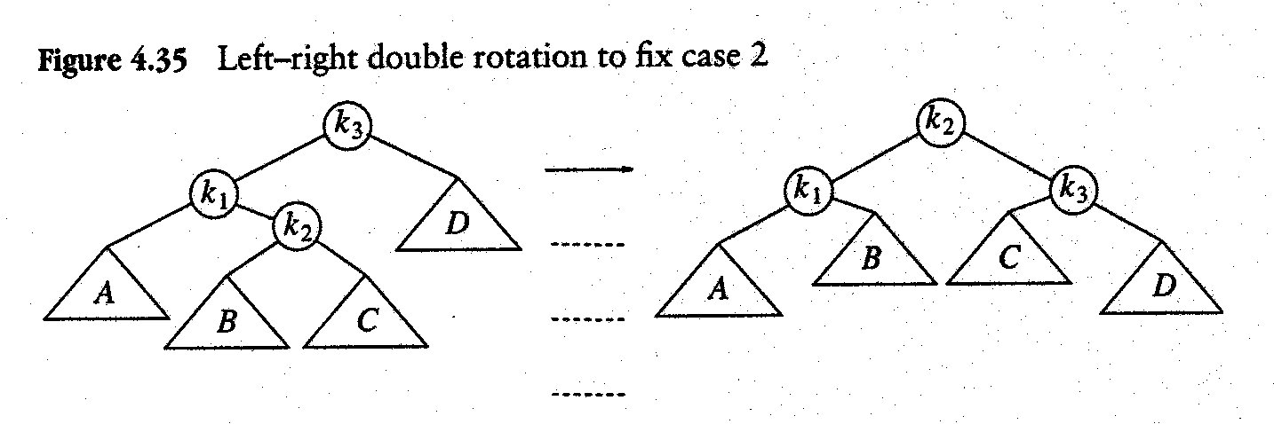
AVL Trees: Implementation
AvlNode* LeftRight(AvlNode*& K3 )
{
}

Slide 14
How often does an insertion into an AVL tree require a subsequent rotation operation?
Karlton (1976) measured operations on hundreds of randomly generated AVL trees. The report stated that
  Aprox. 54% of the time no rotation is needed
  Aprox. 46% of the time rotation is needed

Slide 15
BigO Analysis
With tree now balanced, the height of tree is guaranteed to be logN.
With logN height, insertion, searching, deletion all will have their BigO as O(logN)
As far as the cost of balancing a tree is concerned, lets take a look at the code.

Slide 16
Deletion of a Node
We delete a node using the procedure of BST
Then we need to check to see if rotations are necessary to perform.
In contrast to the insert algorithm, we may need to perform multiple rotations.
  In the worst case, we may need a rotation at each level of the tree, O(logN) rotations may be required

